Slide 1

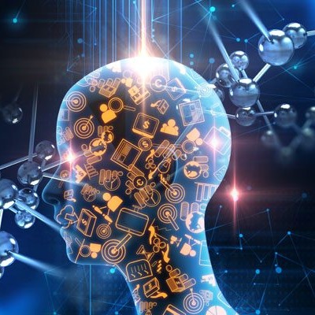
Machine Learning
WELCOME TO
ML

Slide 2
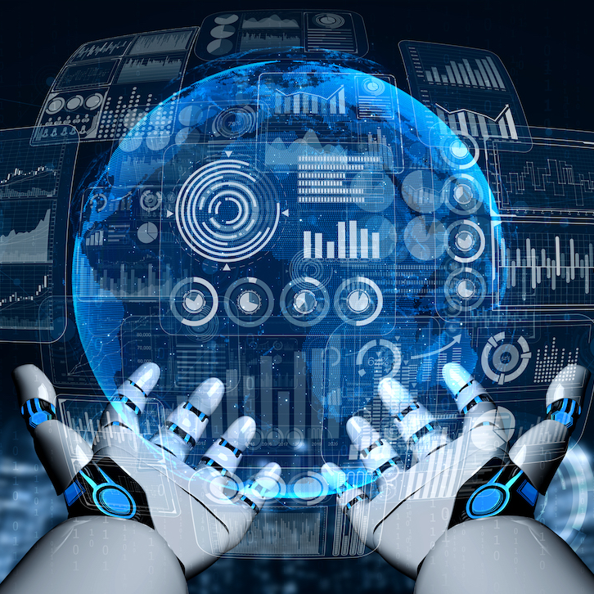
TODAY!!!!
Administration details
Why is machine learning so cool?

Slide 3
Textbook!!!!
Christopher Bishop: ”Pattern Recognition and Machine Learning”, 2006
Other Textbooks:
Kevin Murphy: ”Machine Learning: a Probabilistic Perspective”
David Mackay: ”Information Theory, Inference, and Learning Algorithms”
Ethem Alpaydin: ”Introduction to Machine Learning”.

Slide 4
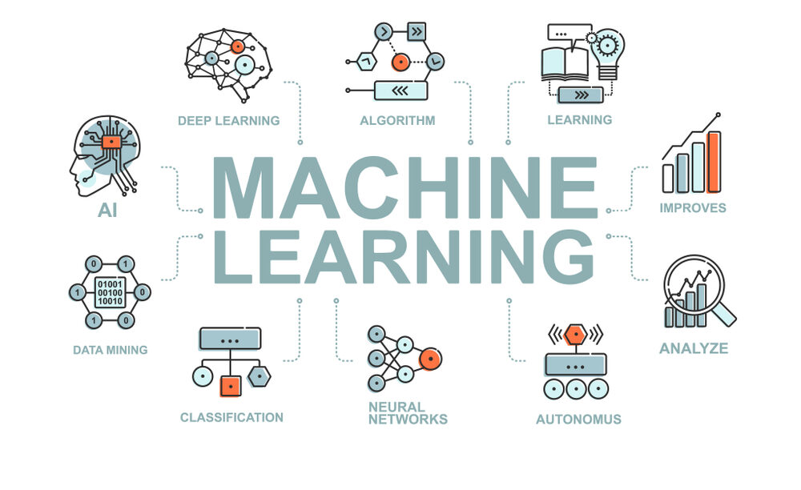

Machine Learning Introduction
Machine Learning
Dr. Adnan Abid
Courtesy SuperDataScience
Introduction to Machine Learning by Dr. Agha Ali Raza
https://www.youtube.com/watch?v=6pM7N6NypcI&list=PLnvLVSNZy9VLfLalXwCY0IasyKTKZboBQ&index=1

Slide 5
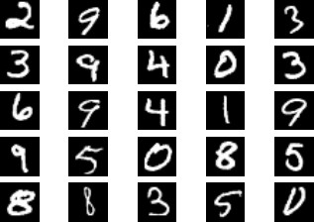

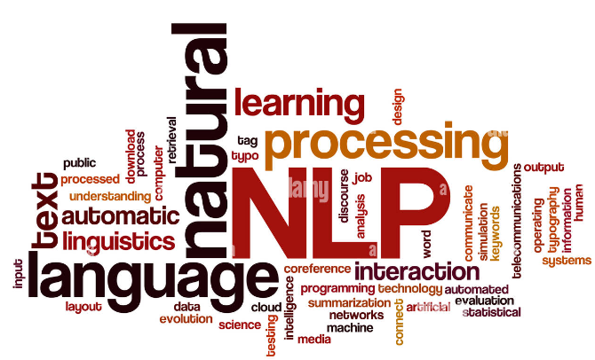
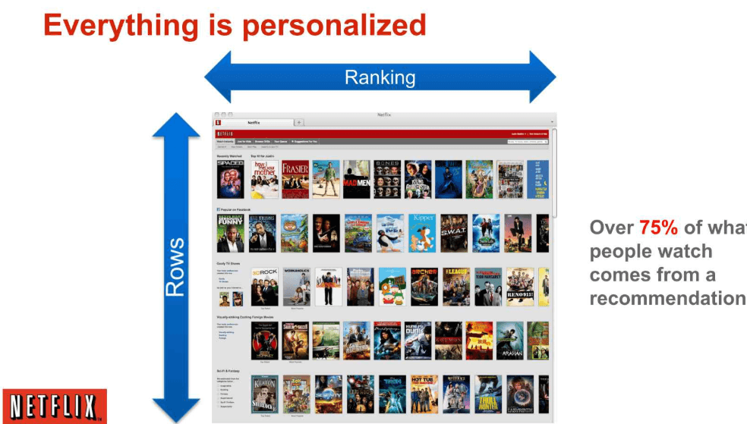
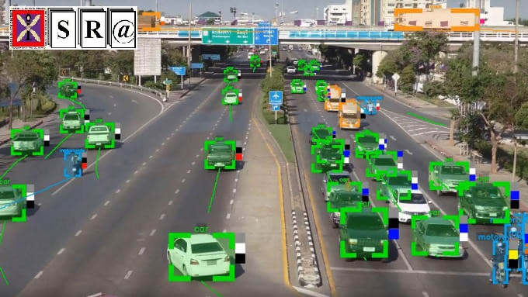

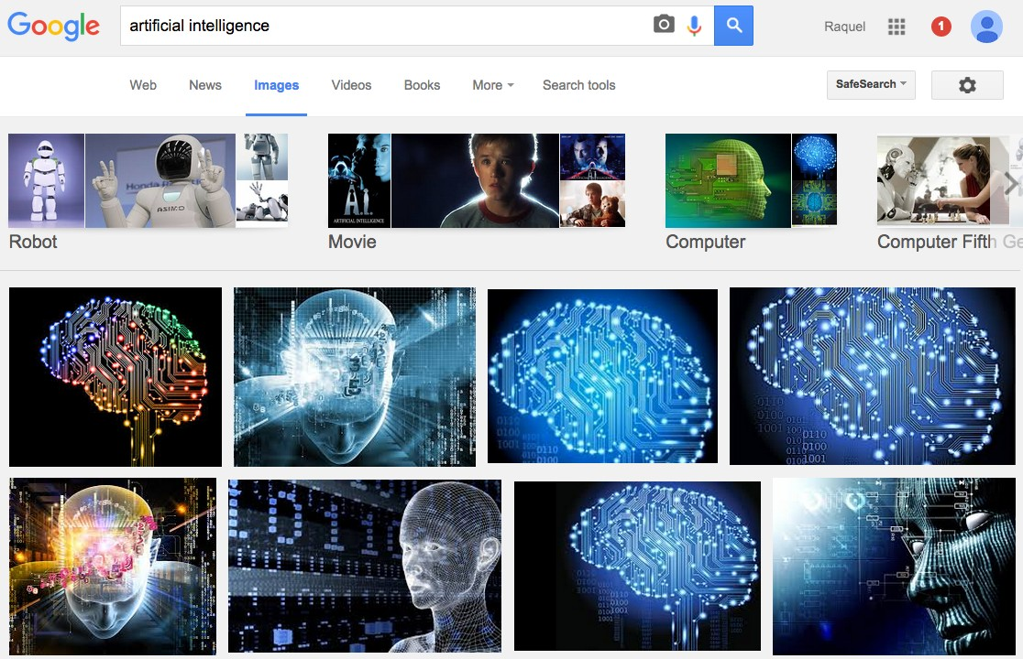
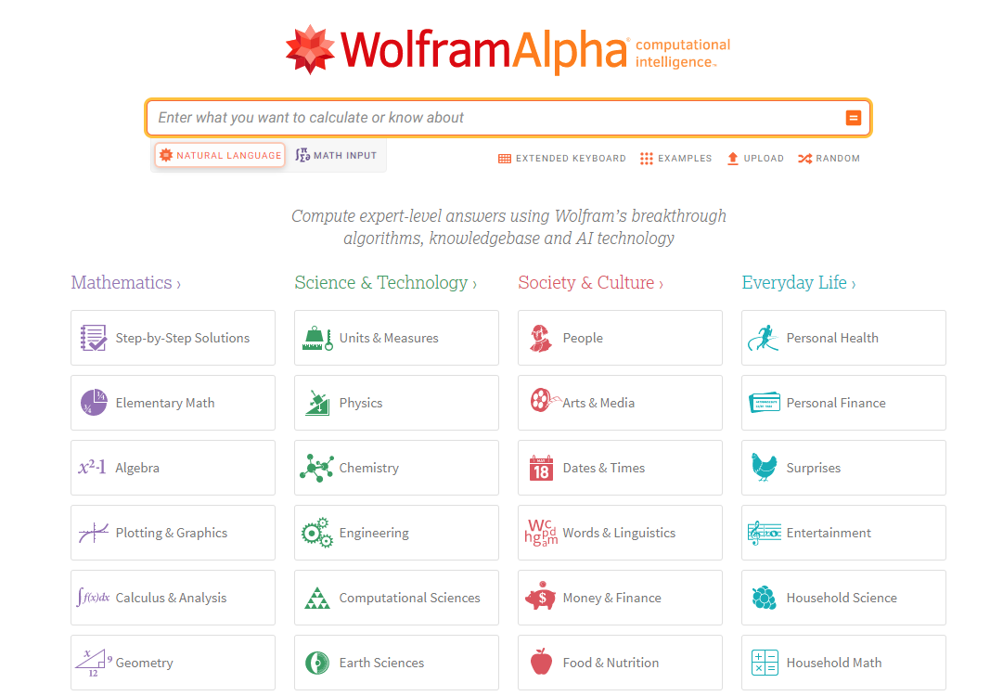
NLP: TEXT & SPEECH PROCESSING
IMAGE PROCESSING & COMPUTER VISION
RECOMMENDER SYSTEMS
INFORMATION RETRIEVAL AND COMPUTATIONAL INTELLIGENCE

Slide 6
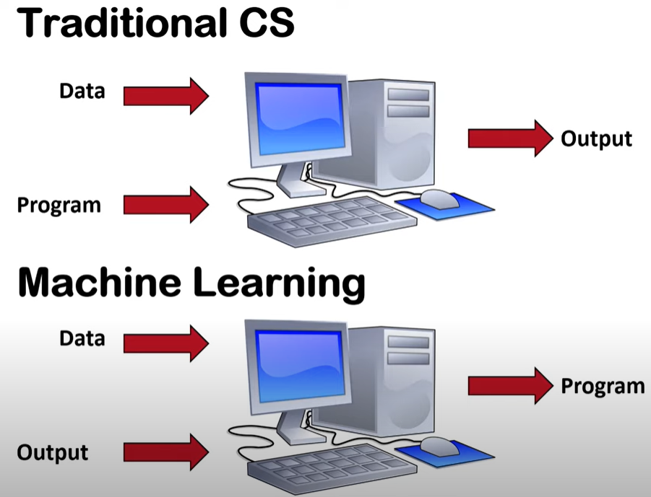
Traditional CS
vs
Machine Learning
Machine Learning by Dr. Adnan Abid

Slide 7
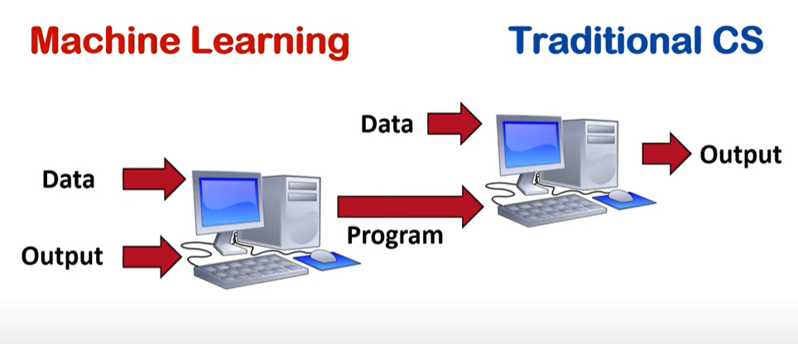
Machine Learning Pipeline
Test
Output
Training
Evaluation
Model
May be Labels
Training
Testing
Machine Learning by Dr. Adnan Abid

Slide 8
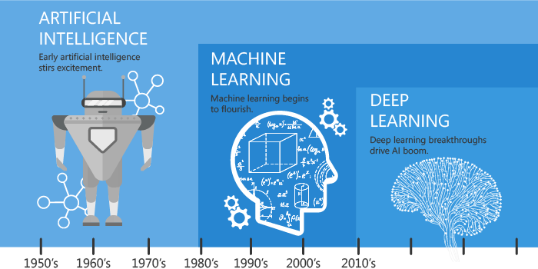
Machine Learning by Dr. Adnan Abid

Slide 9

Machine Learning by Dr. Adnan Abid

Slide 10
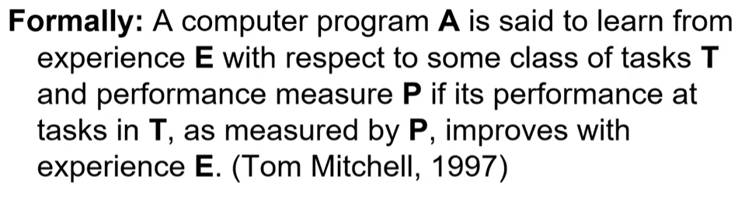

What is Machine Learning

Slide 11

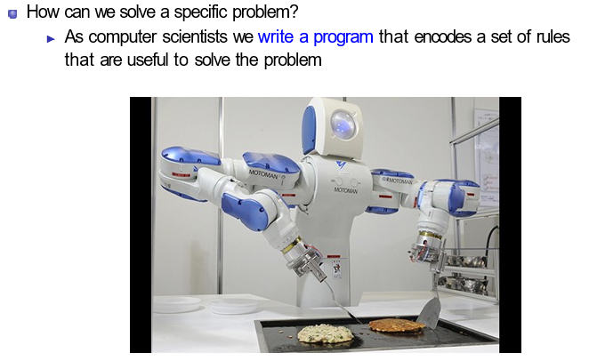
Machine Leanring

Slide 12






Determing in Machine Learning
In many cases is very difficult to specify those rules, e.g., given a picture determine whether there is a cat in the image

Slide 13
Machine Learning
Learning systems are not directly programmed to solve a problem, instead develop own program based on:
Examples of how they should behave
From trial-and-error experience trying to solve the problem
Different than standard CS:
Want to implement unknown function, only have access e.g., to sample input-output pairs (training examples)
Learning simply means incorporating information from the training examples into the system

Slide 14
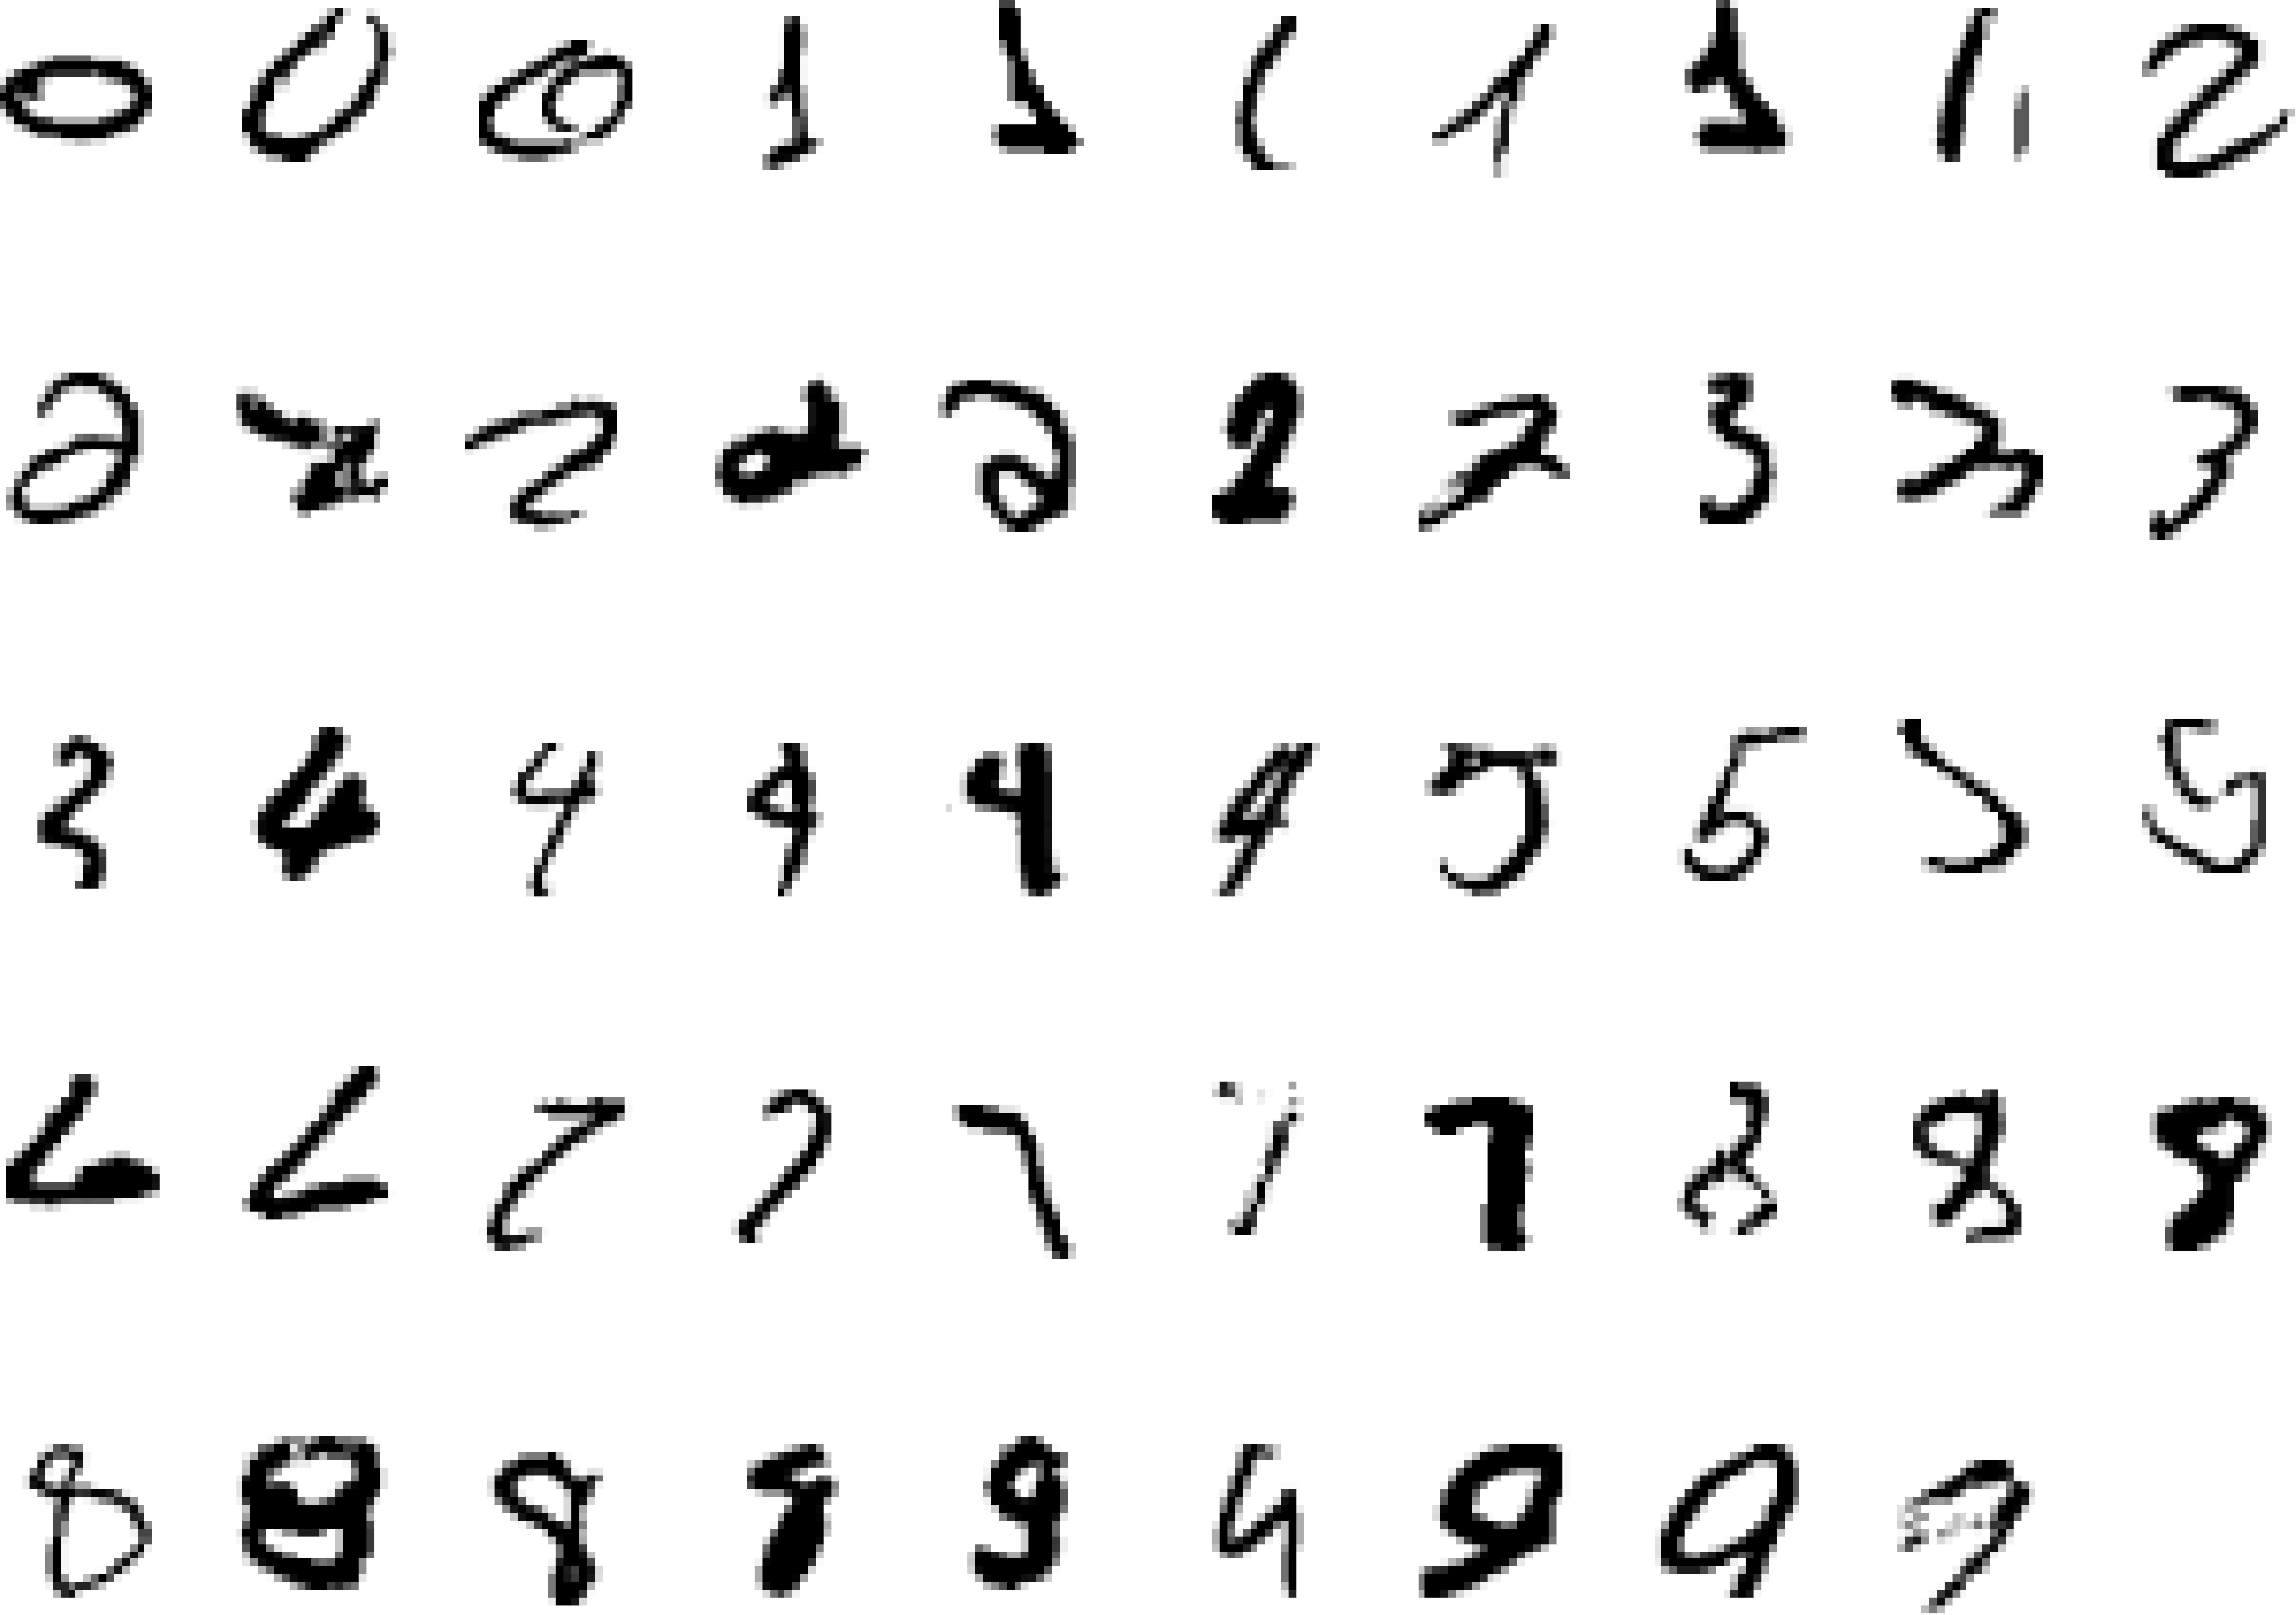
Machine Leanring
Tasks that requires machine learning: What makes a 2?

Slide 15
Why we use Machine Learning ?
Machine learning is important because
it gives enterprises a view of trends in customer behavior and business operational patterns, as well as supports the development of new products.
Many of today's leading companies, such as Facebook, Google and Uber, make machine learning a central part of their operations.

Slide 16
Learning algorithms are useful in other tasks
Classification: Determine which discrete category the example is
Recognizing patterns: Speech Recognition, facial identity, etc
Recommender Systems: Noisy data, commercial pay-off (e.g., Amazon, Netflix).
Information retrieval: Find documents or images with similar content
Computer vision: detection, segmentation, depth estimation, optical flow, etc
Robotics: perception, planning, etc
Learning to play games
Computational Intelligence: Solving complex problems using Knowledge base and AI – Wolfram Alpha
Recognizing anomalies: Unusual sequences of credit card transactions, panic situation at an airport
Spam filtering, fraud detection: The enemy adapts so we must adapt too
Many more!

Slide 17
Learning algorithms are useful in many tasks
1. Classification: Determine which discrete category the example is

Slide 18


Examples of Classification
Am I going to pass the exam?
Is this a dog?
21 / 44

Slide 19
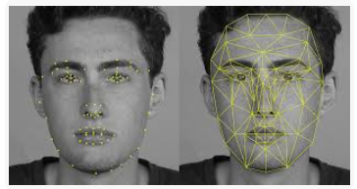
Learning algorithms are useful in many tasks
2. Recognizing patterns: Speech Recognition, facial identity, etc
Figure: Siri: https://www.youtube.com/watch?v=8ciagGASro0
Facial Recognition

Slide 20

Learning algorithms are useful in many tasks
3.Recommender Systems: Recommendation of Products on Amazon, Daraz, Netflix, YouTube, Facebook).
Examples of Recommender Systems

Slide 21
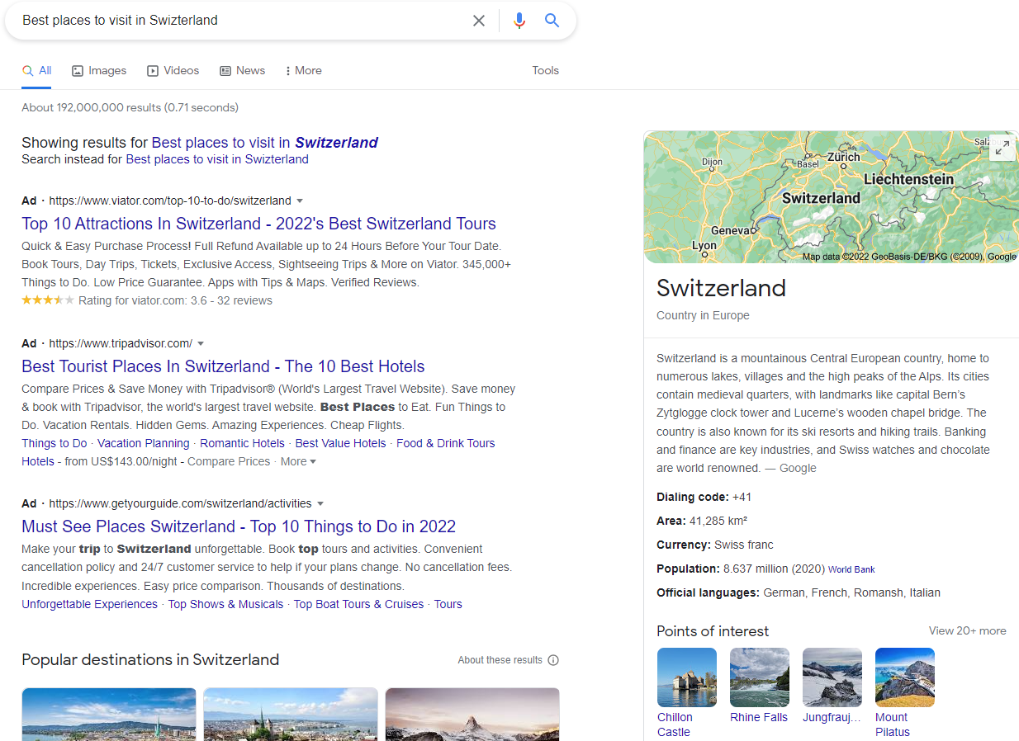
Learning algorithms are useful in many tasks
4. Information retrieval: Find documents or images with similar content
Examples of Information retrieval

Slide 22
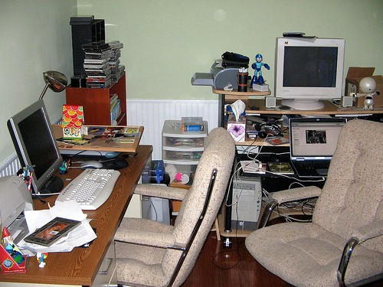
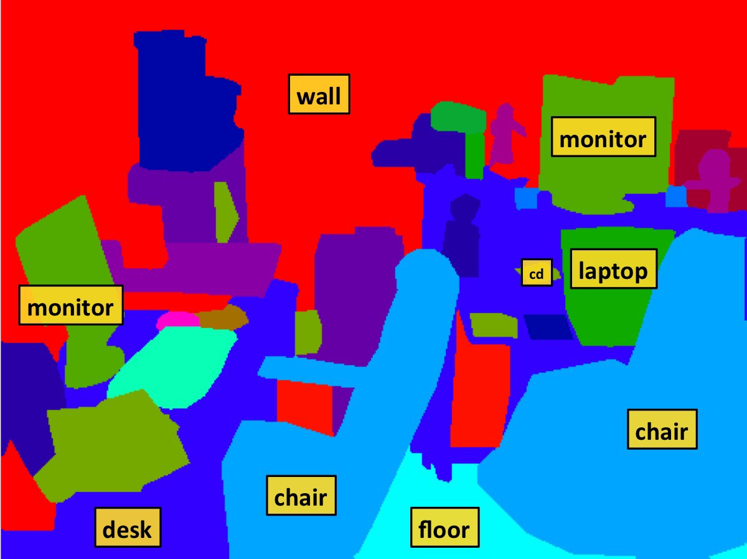
Learning algorithms are useful in many tasks
5. Computer vision: detection, segmentation, depth estimation, optical flow, etc
Examples of Computer vision

Slide 23
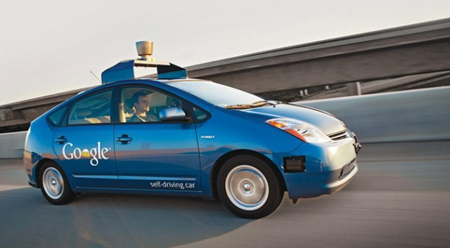
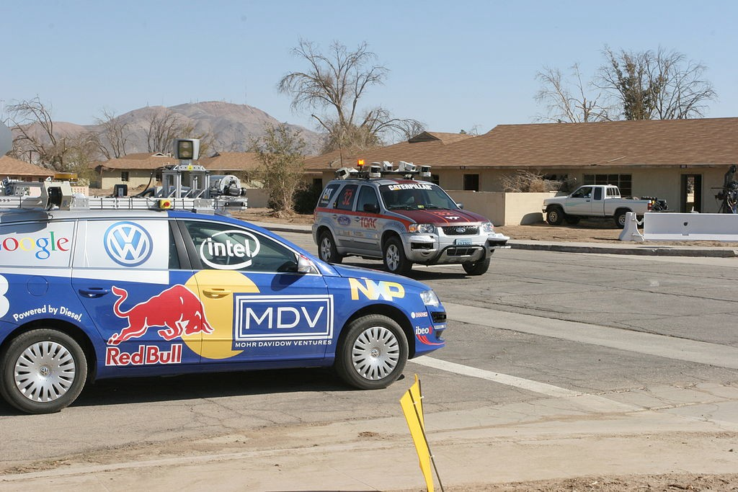
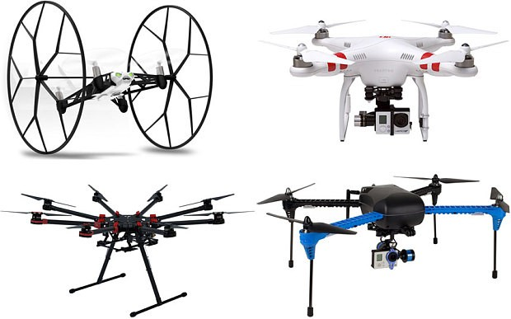
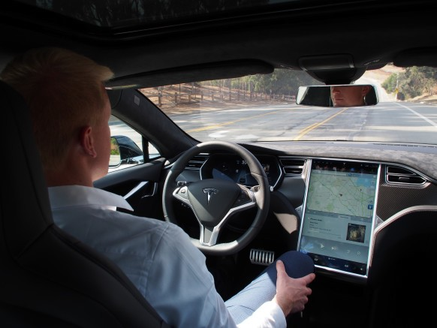
Learning algorithms are useful in many tasks
6. Robotics: perception, planning, etc
Flying Robots
Source: https://www.youtube.com/watch?v=YQIMGV5vtd4

Slide 24

Learning algorithms are useful in many tasks
7. Learning to play games
Playing Games: Atari
Figure: Video: https://www.youtube.com/watch?v=V1eYniJ0Rnk

Slide 25
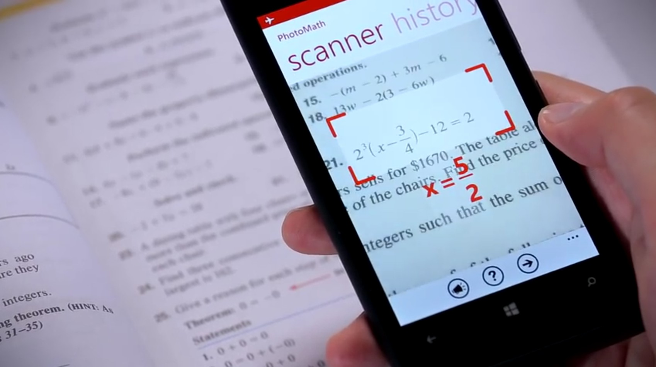
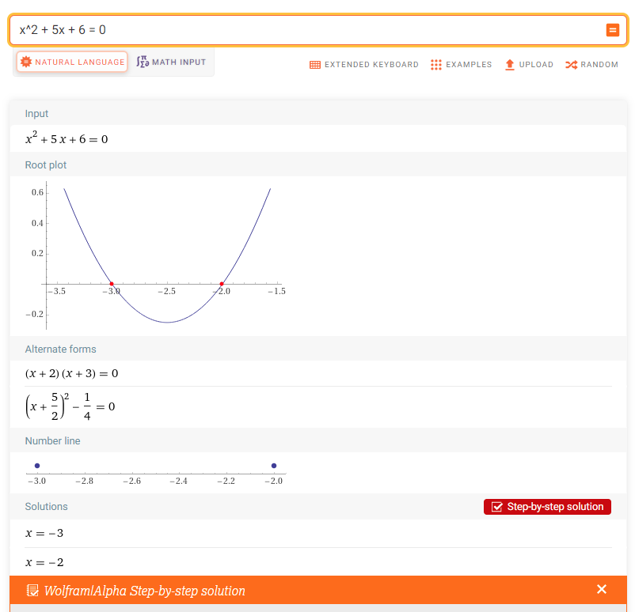
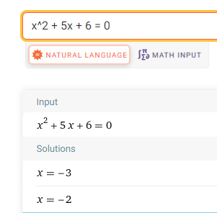
Learning algorithms are useful in many tasks
8. Computational Intelligence: Solving Mathematical Problems: Algorithms, Knowledge-base, AI

Slide 26
Types of Learning

Slide 27
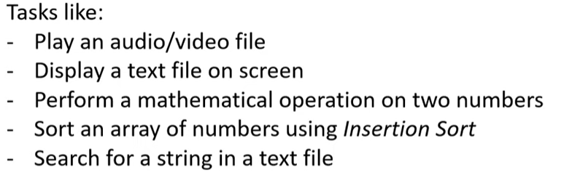
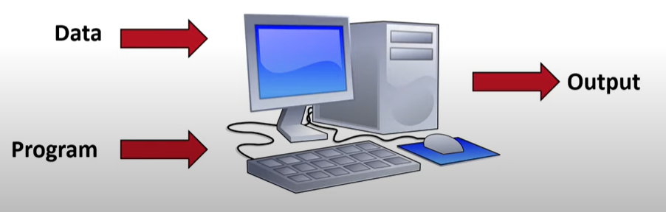
Traditional Computer Science
Introduction to Machine Learning by Dr. Agha Ali Raza
https://www.youtube.com/watch?v=6pM7N6NypcI&list=PLnvLVSNZy9VLfLalXwCY0IasyKTKZboBQ&index=1

Slide 28
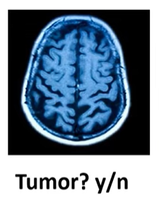
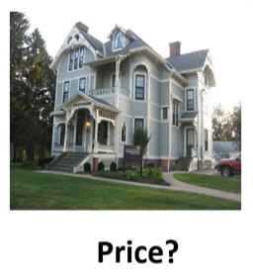
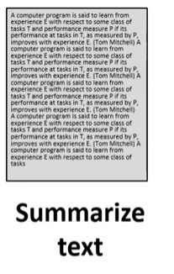
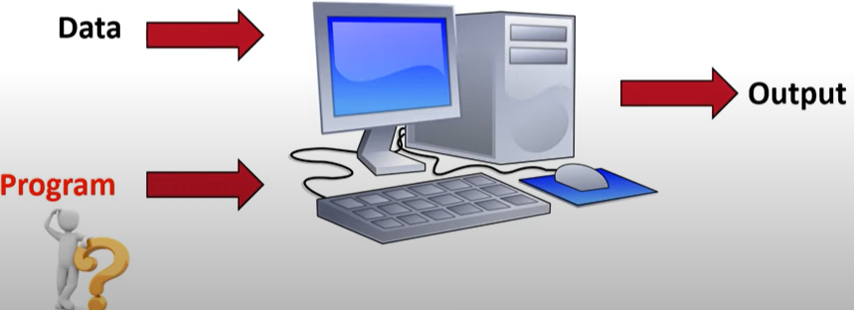
Will Traditional CS Work?
Introduction to Machine Learning by Dr. Agha Ali Raza
https://www.youtube.com/watch?v=6pM7N6NypcI&list=PLnvLVSNZy9VLfLalXwCY0IasyKTKZboBQ&index=1

Slide 29
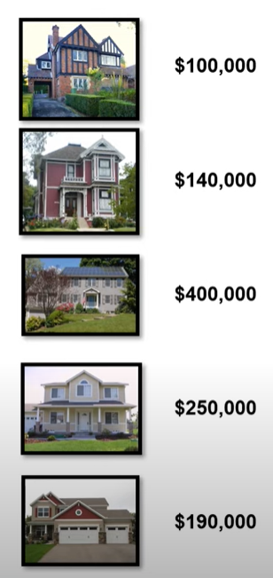
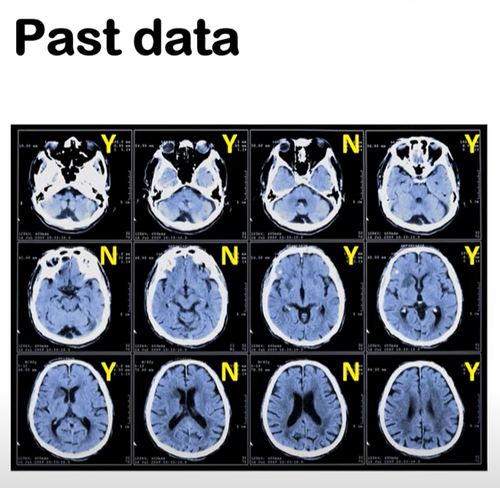
Make the Machine Learn
Introduction to Machine Learning by Dr. Agha Ali Raza
https://www.youtube.com/watch?v=6pM7N6NypcI&list=PLnvLVSNZy9VLfLalXwCY0IasyKTKZboBQ&index=1

Slide 30
Traditional CS
vs
Machine Learning
Introduction to Machine Learning by Dr. Agha Ali Raza
https://www.youtube.com/watch?v=6pM7N6NypcI&list=PLnvLVSNZy9VLfLalXwCY0IasyKTKZboBQ&index=1

Slide 31
Machine Learning Pipeline
Test
Output
Training
Evaluation
Model
May be Labels
Training
Testing
Introduction to Machine Learning by Dr. Agha Ali Raza
https://www.youtube.com/watch?v=6pM7N6NypcI&list=PLnvLVSNZy9VLfLalXwCY0IasyKTKZboBQ&index=1

Slide 32
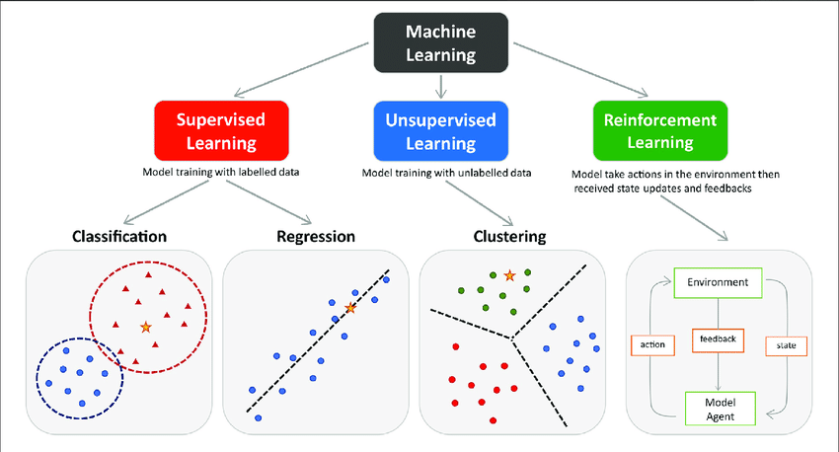
Types of Learning

Slide 33


Slide 34
MACHINE LEARNING

Slide 35
MACHINE LEARNING

Slide 36
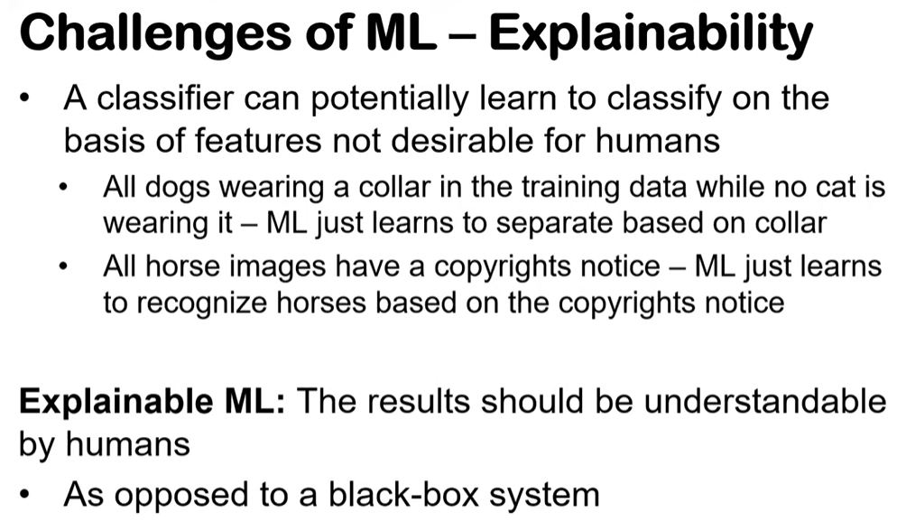
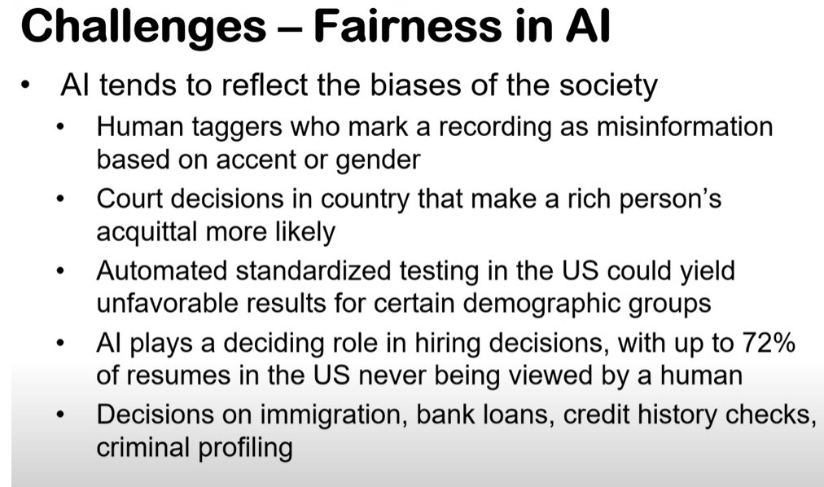
MACHINE LEARNING Challenges

